Slide 1
Weld Defect Detection
INFO-6146 Capstone Project
By: Abdallah Seyam
1340973

Slide 2
Abstract
Developed a CNN-based image classification system to detect five types of weld defects. Utilized a YOLO-annotated dataset and trained a ResNet18 model using PyTorch. Achieved 75.43% final training accuracy and 76.30% test accuracy. Evaluation included accuracy per class, confusion matrices, and training/validation curves.

Slide 3
Introduction
Weld defects pose serious safety risks.
Manual inspection is time-consuming and prone to human error.
Used weld detect detection data from kaggle

Slide 4
Dataset and Preprocessing
Images stored in train/images; labels in train/labels
Labels are in YOLO .txt format (first class ID used for classification)
5 defect classes:
0- Adjacent Defects (adj)
1- Integrity Defects (int)
2- Geometry Defects (geo)
3- Post-Processing Defects (pro)
4- Non-Fulfillment Defects (non)
All images resized to 224×224 pixels before training

Slide 5
Model Architecture
Model: ResNet18, final FC layer modified for 5-class output
Loss Function: CrossEntropyLoss
Optimizer: Adam (lr = 0.001)
Input Size: 224×224 images
Activation: Softmax

Slide 6
Training Details
Epochs: 25
Batch Size: 16
Split: 70% training, 15% validation, 15% test
Transformations: Data augmentation (horizontal flip, color jitter, rotation) applied to training set
Optimizer: Adam (LR = 0.001)
Validation Accuracy (Peak): 69.36%
Test Accuracy (Final): 76.30%

Slide 7
Results Summary
Test Accuracy: 76.30%
Best Validation Accuracy: 69.36%
Training Accuracy: 75.43%
Confusion Matrix: Shows strong results for Integrity and Geometry defects
Weak classes: Post-Processing (12.5%), Non-Fulfillment (40%)
Accuracy variation reflects dataset imbalance and visual class similarity

Slide 8
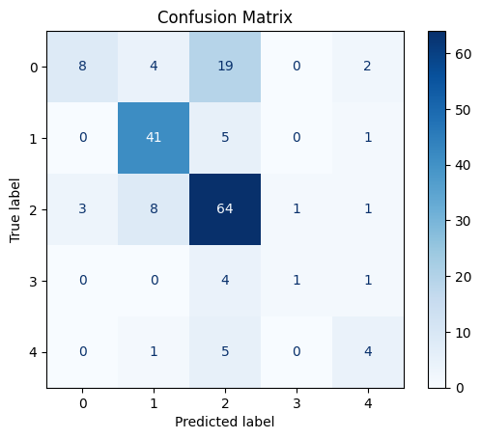

Slide 9
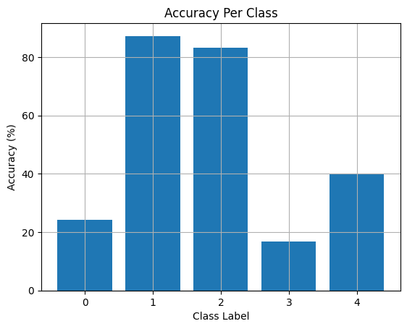

Slide 10
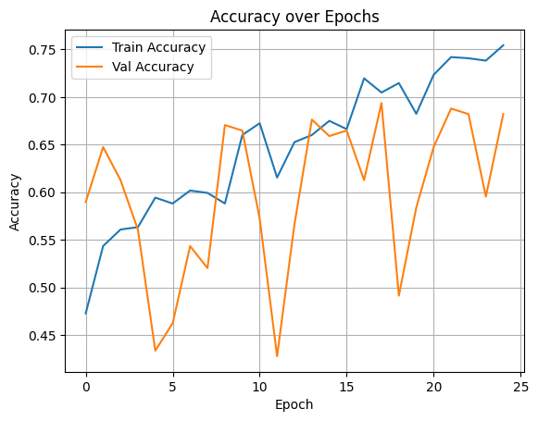

Slide 11
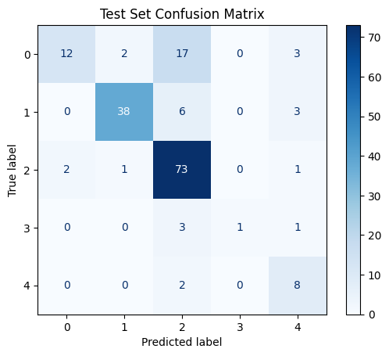

Slide 12
Accuracy Per Class
Class 0 (Adjacent): 24.24%
Class 1 (Integrity): 87.23%
Class 2 (Geometry): 83.12%
Class 3 (Post-Processing): 16.67%
Class 4 (Non-Fulfillment): 40.00%

Slide 13
Observations
Performance varied significantly across classes
Highest accuracy on well-represented classes (Integrity, Geometry)
Lowest accuracy on underrepresented classes (Post-Processing, Non-Fulfillment)
Class imbalance and visual similarity likely impacted minority class performance
Data augmentation and transfer learning could enhance model generalization
ResNet18 served as a solid baseline for defect classification

Slide 14
Conclusion
The CNN model effectively detected weld defects with solid overall accuracy.
Best results observed for well-represented classes.
Underperformance on rare classes suggests need for data augmentation, oversampling, or class-weighted loss.
Future improvements:
Use pretrained ResNet18 (transfer learning)
Apply class balancing

